Slide 1
From cluster to voxels From absolutely to comparatively
Searchlight and RSA method
Reporter: Xiaokai Xia
Date: 2019-07-08

Slide 2
Searchlight
Information-based analysis

Slide 3
Abstract
Standard fMRI analysis method based on that
A cluster active as a whole
Need to extract cluster and smooth graph
Smoothing will lose more information
Using information from unsmoothed activity pattern
Q: Patchy and inconsistence across subjects
A: Detect where activity pattern change
How to
Sampling by searchlight
Compare the difference
Univariate analysis
Multivariate analysis ( Distance, SVM, Cross validation )

Slide 4
Standard fMRI analysis
Early neuroimaging experiments using PET
Activity was measured in the centimeter range
The voxel were similar in size to the functional regions
The experiment is designed to activate a functional region as a whole
Nowadays fMRI have increased spatial resolution
The basis of theory have no changed
“salt-and-pepper” pattern
Smoothing to remove noise
Controlling the false-positive rate
The amount of information also be removed

Slide 5
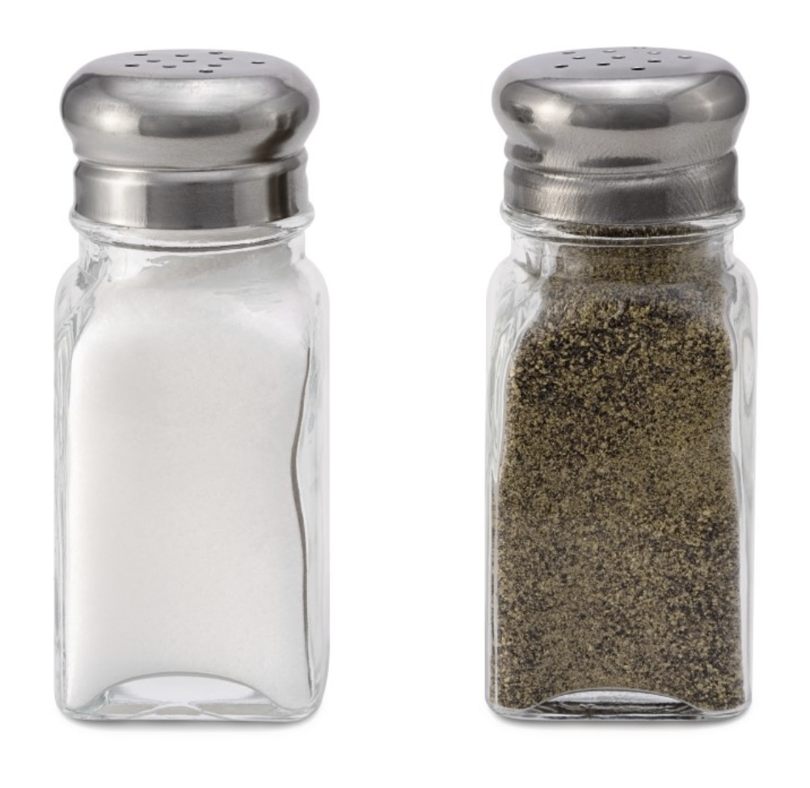
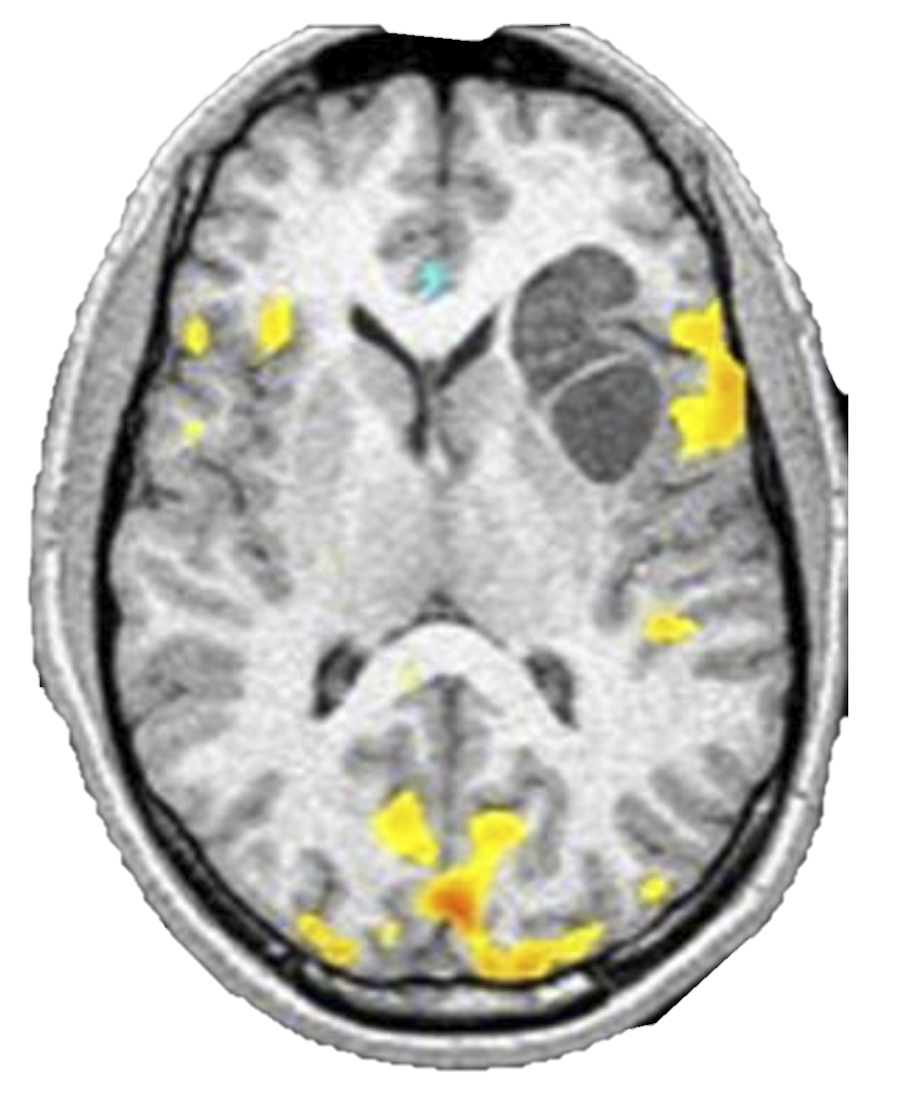
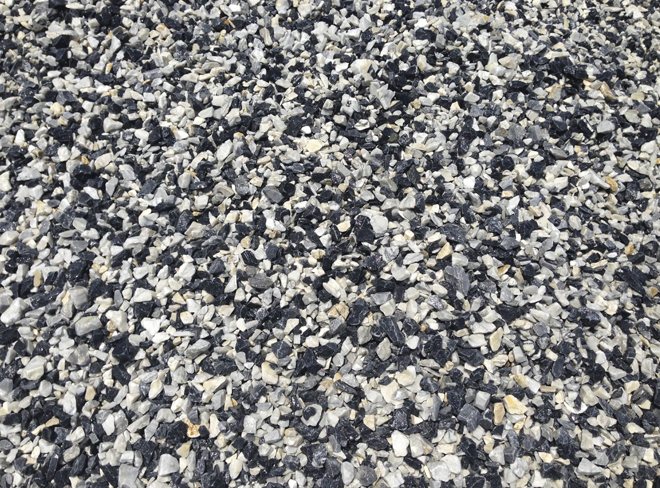

Slide 6
Standard fMRI analysis
Early neuroimaging experiments using PET
Activity was measured in the centimeter range
The voxel were similar in size to the functional regions
The experiment is designed to activate a functional region as a whole
Nowadays fMRI have increased spatial resolution
The basis of theory have no changed
“salt-and-pepper” pattern
Smoothing to remove noise
Controlling the false-positive rate
The amount of information also be removed

Slide 7
Information-based analysis
Now fMRI is invading the submillimeter range
Unsmoothed fMRI activity pattern
Q : Patchy and inconsistence between subjects
A: Thought it as distributed representations

Slide 8
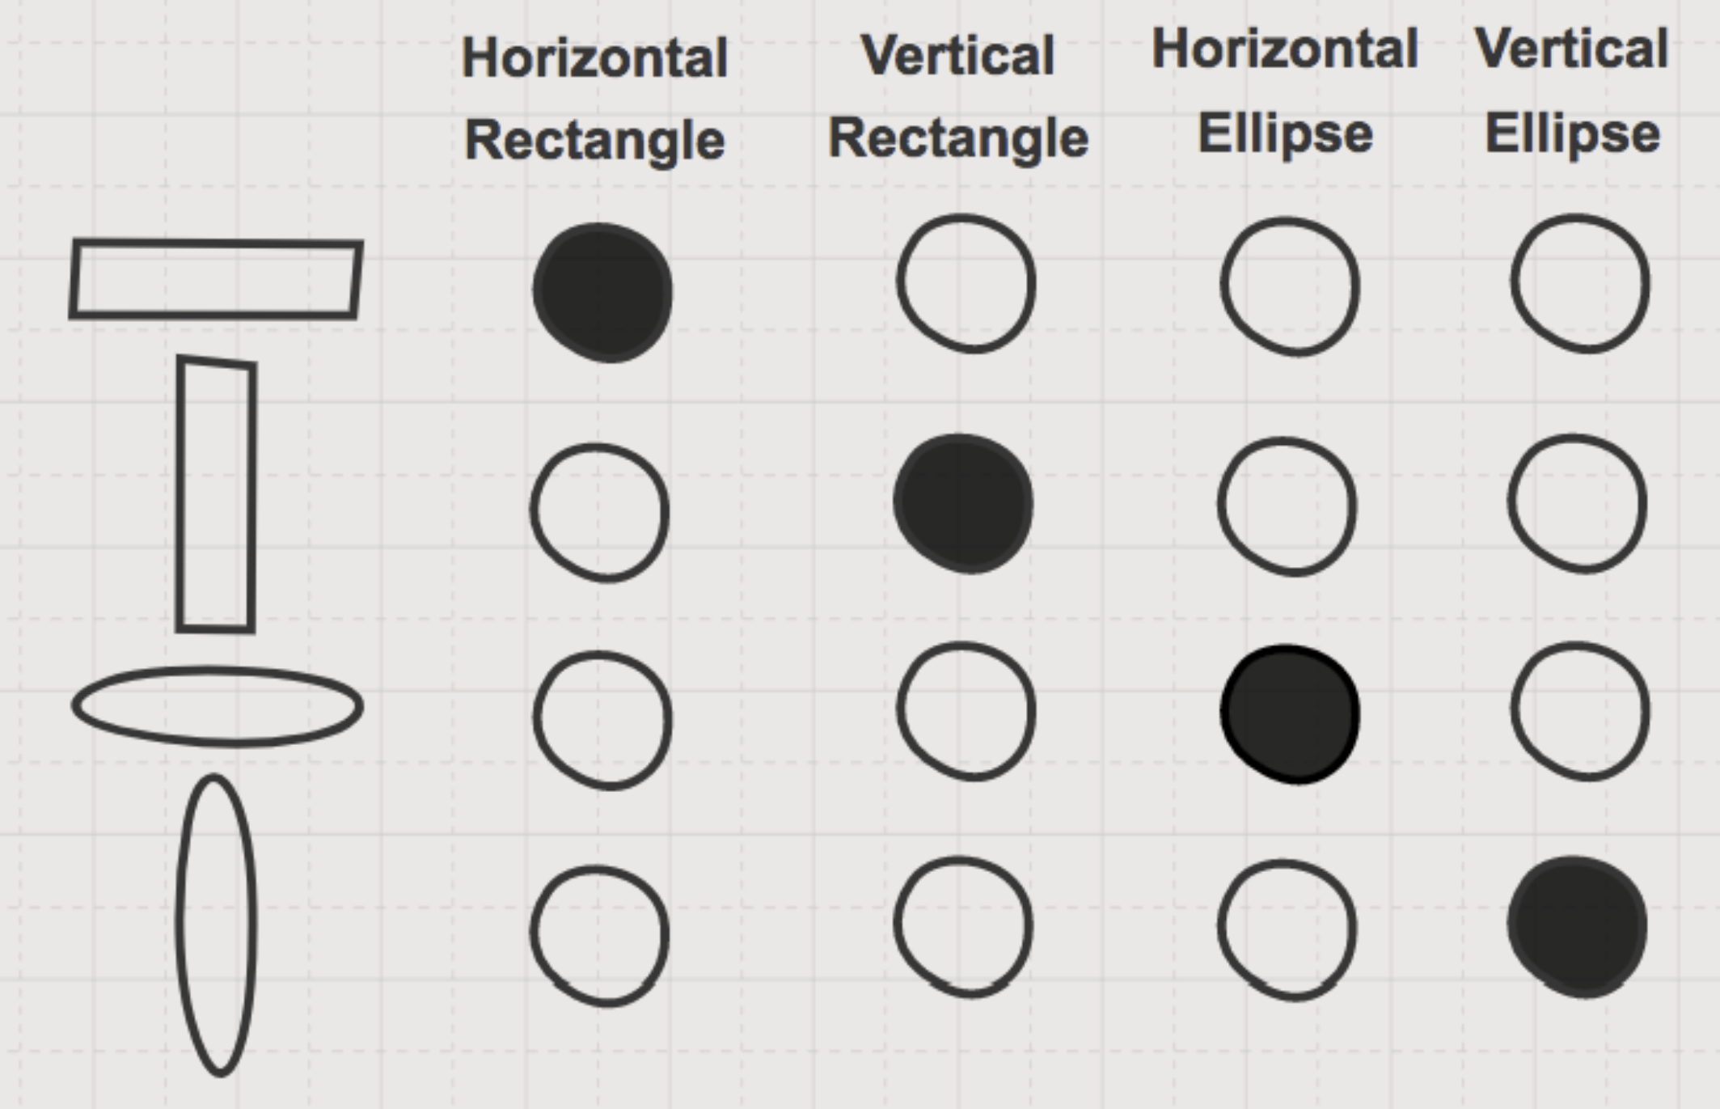

Slide 9
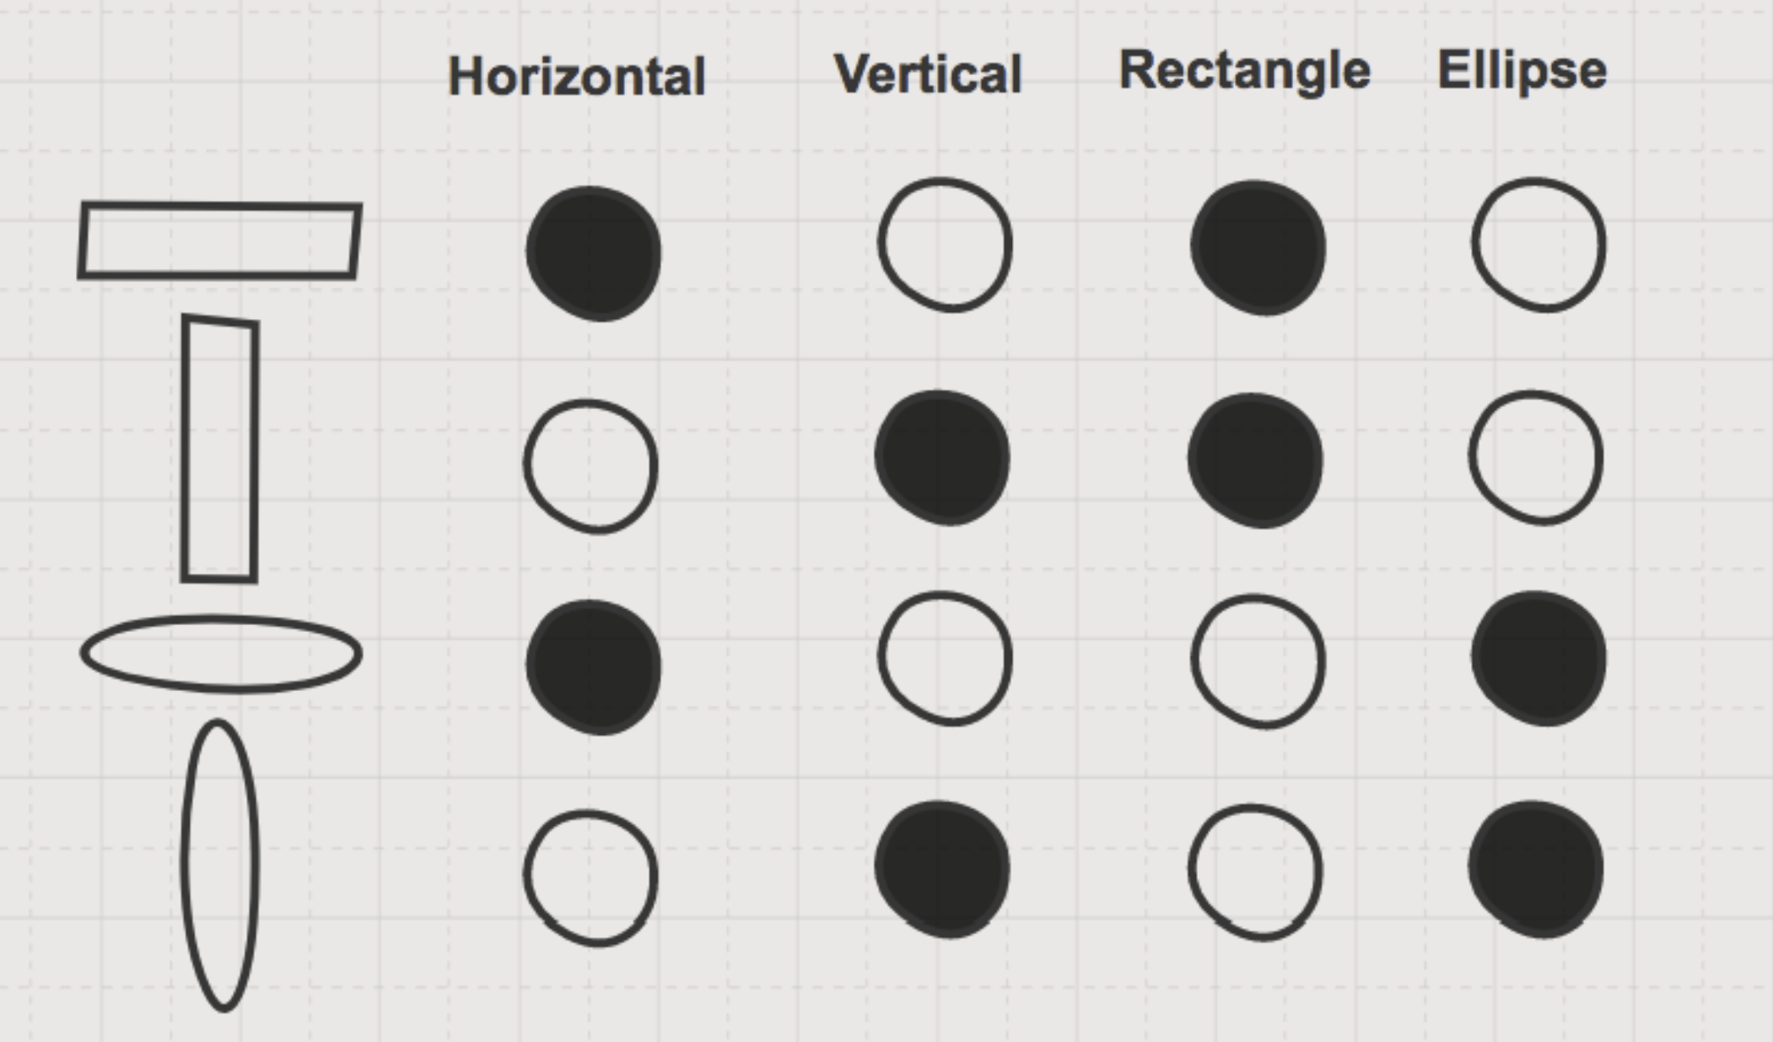

Slide 10
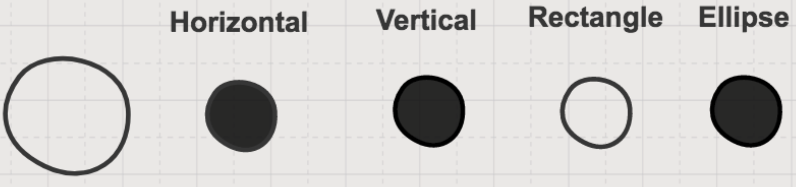

Slide 11
Information-based analysis
Now fMRI is invading the submillimeter range
Unsmoothed fMRI activity pattern
Q : Patchy and inconsistence between subjects
A: Thought it as distributed representations
Information-based analysis
Detect where in the brain the local activity pattern changes between conditions

Slide 12
How-to
Spherical Multivariate Searchlight
Multivariate Effect Statistics

Slide 13
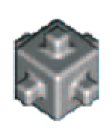
How-to
Spherical Multivariate Searchlight
Centered on each voxel in turn
X-mm radius
E.g. 4-mm radius comprise 33 voxels of 2-mm width
Multivariate Effect Statistics

Slide 14
How-to
Spherical Multivariate Searchlight
Multivariate Effect Statistics
Suppose
Activity pattern is replicable in each conditions
Estimate the response amplitude at a given voxel as a least-squares fit of a predictor time course for each condition
Method
Average absolute t value
Mahalanobis distance
SVM ( or other classifier )
Linear model

Slide 15
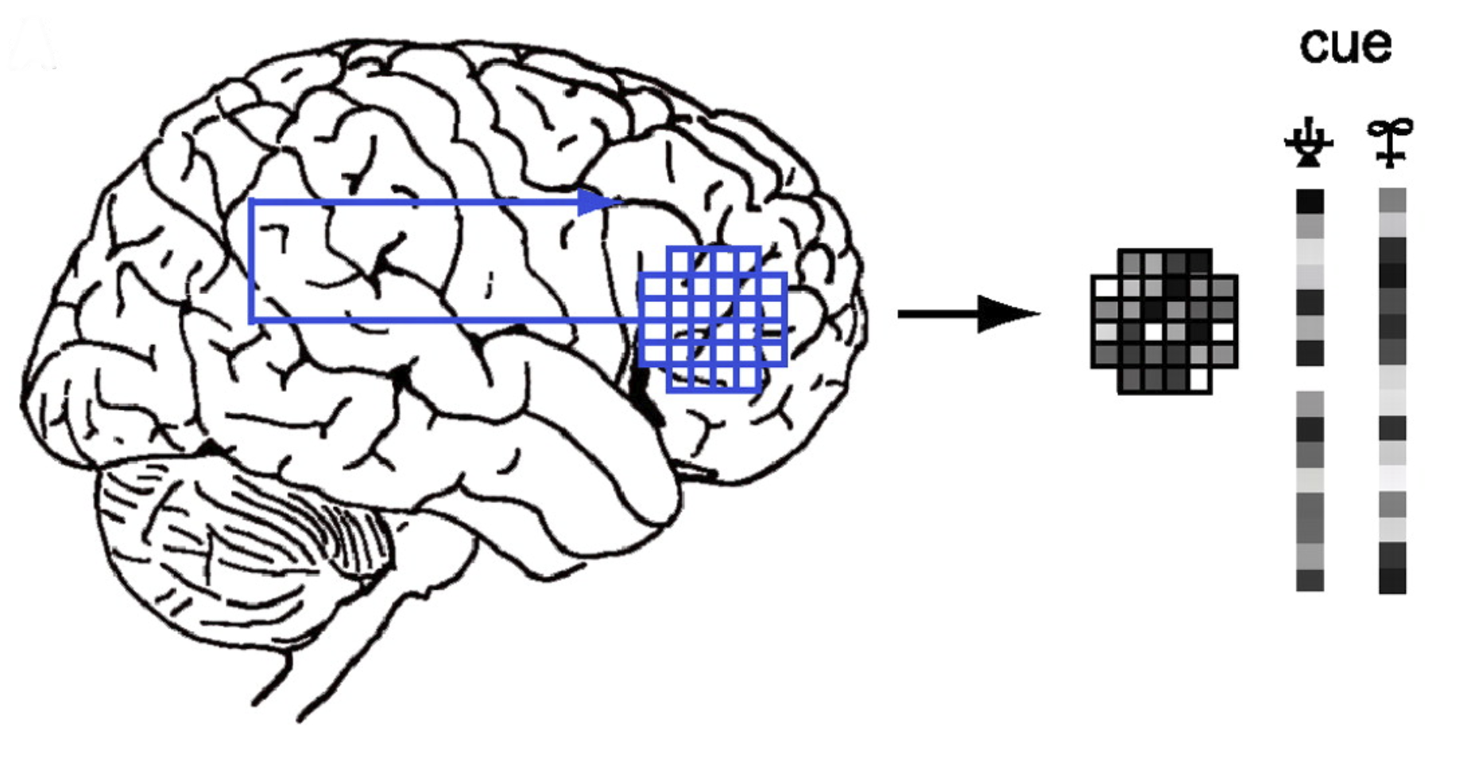
Searchlight sampling

Slide 16
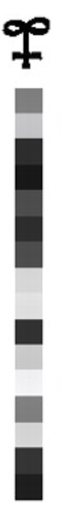
Searchlight sampling

Slide 17
Average absolute t value
Obtain a t value for each voxel
Average the absolute t values within the searchlight

Slide 18
Mahalanobis distance

Slide 19
Mahalanobis distance

Slide 20
Vector distance

Slide 21
Vector distance

Slide 22
Vector distance
[a, b]’
b
a

Slide 23
Vector distance
b
a

Slide 24
Vector distance
b
a

Slide 25
Euclidean distance
b
a

Slide 26
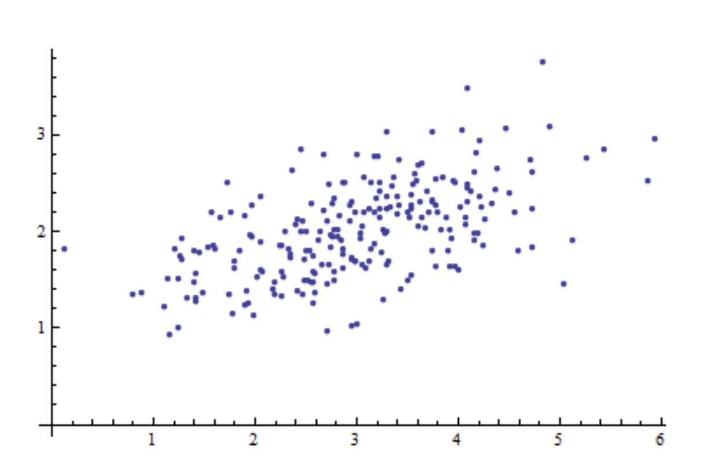
Mahalanobis distance

Slide 27
Mahalanobis distance

Slide 28
Mahalanobis distance

Slide 29
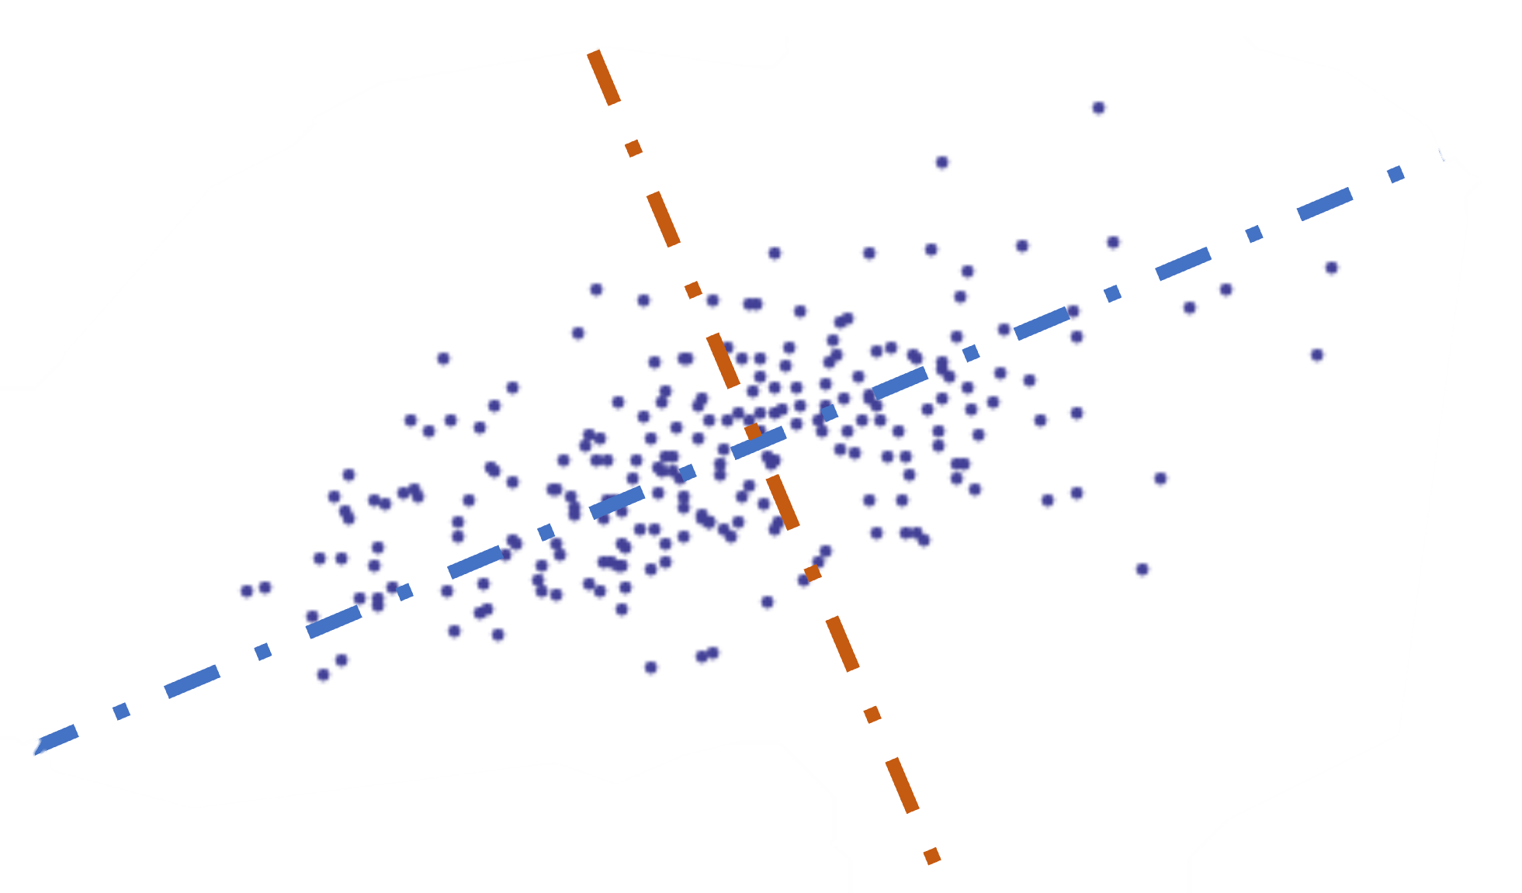
Mahalanobis distance

Slide 30
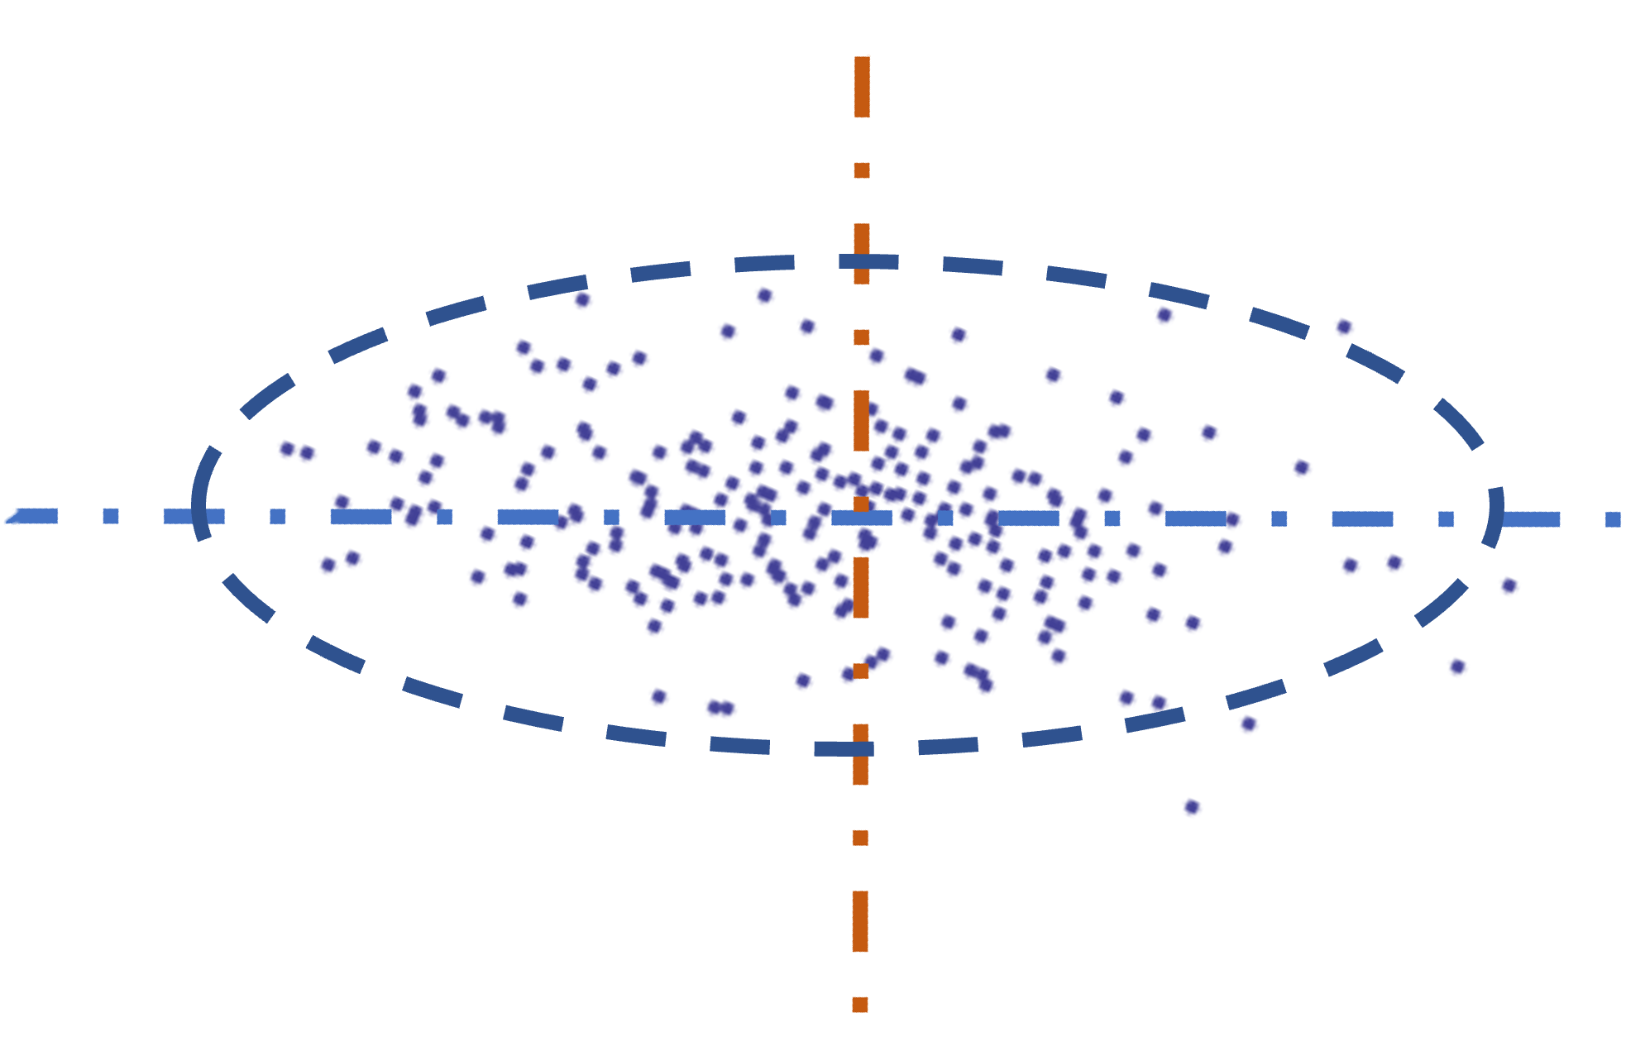
Mahalanobis distance

Slide 31
Mahalanobis distance

Slide 32
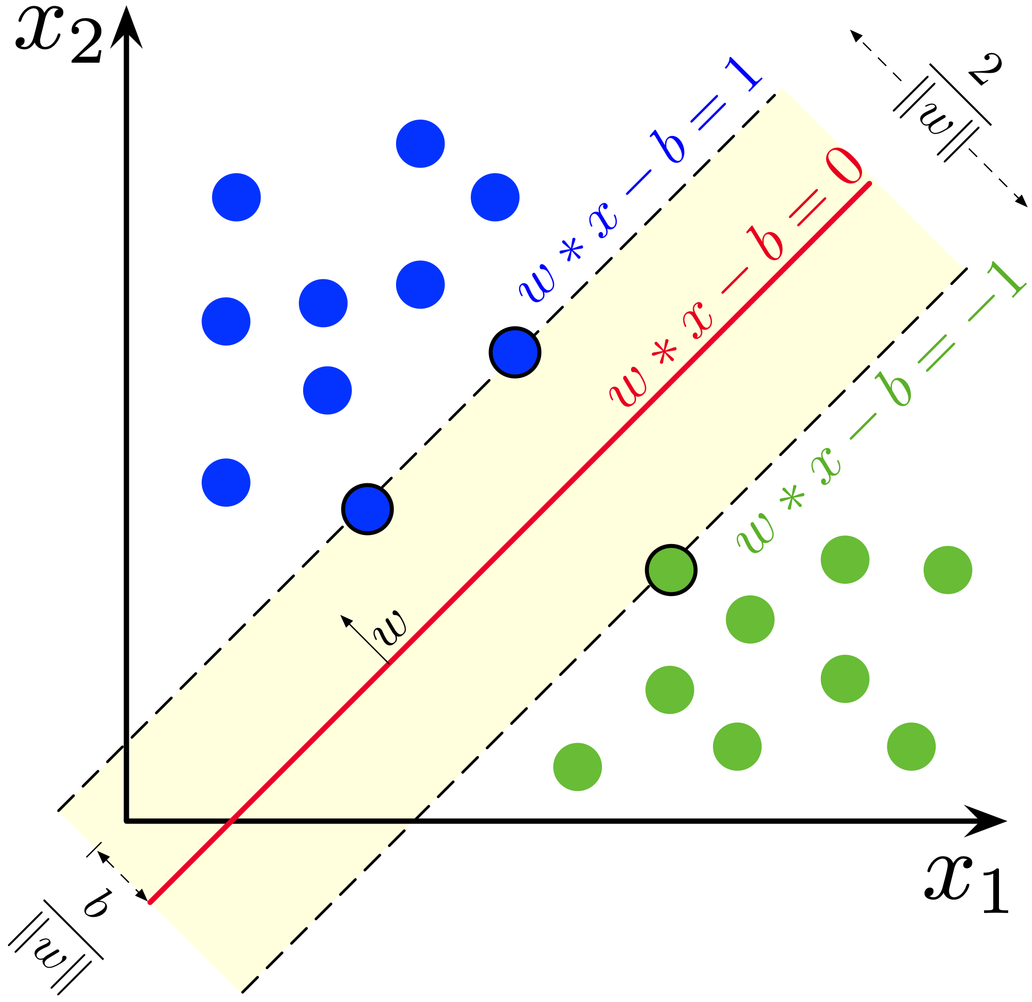
SVM

Slide 33
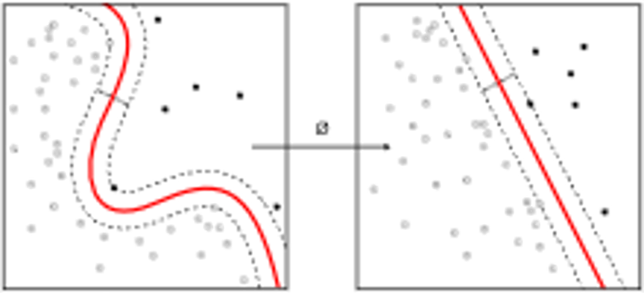
SVM – Adv. 1

Slide 34
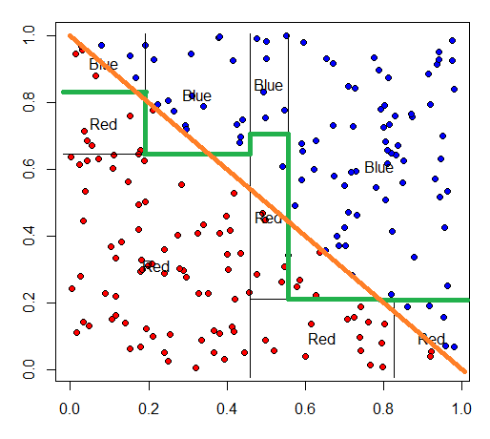
SVM – Adv. 2

Slide 35
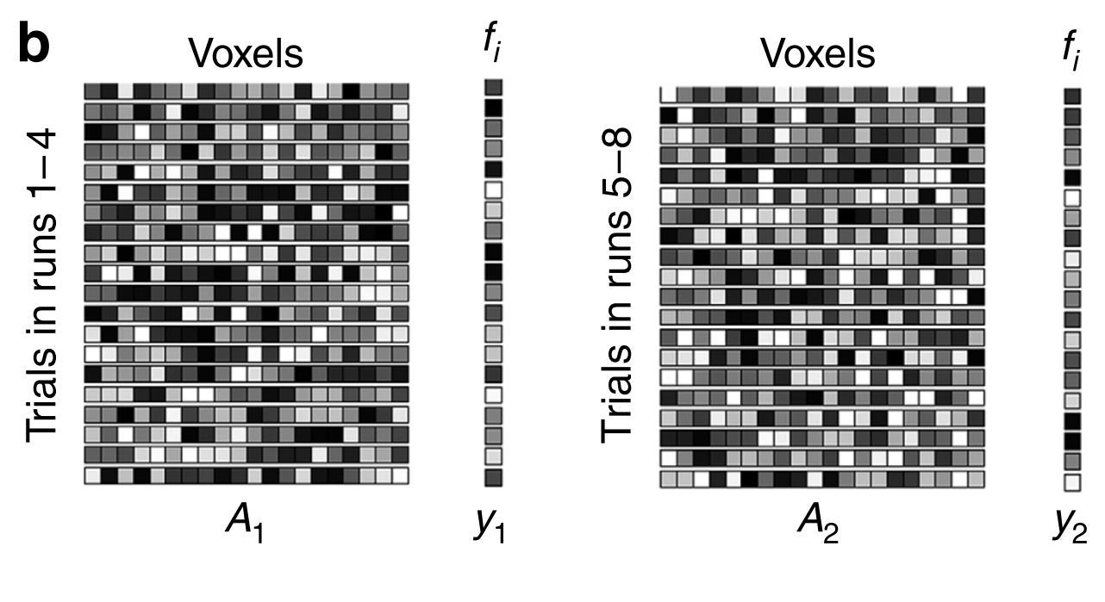
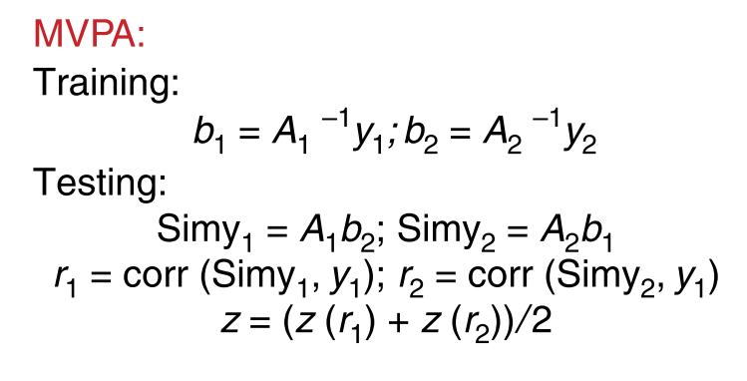
Linear Model

Slide 36
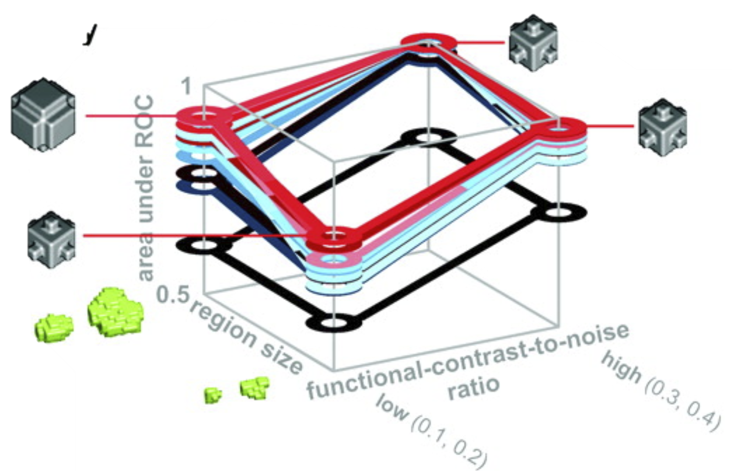
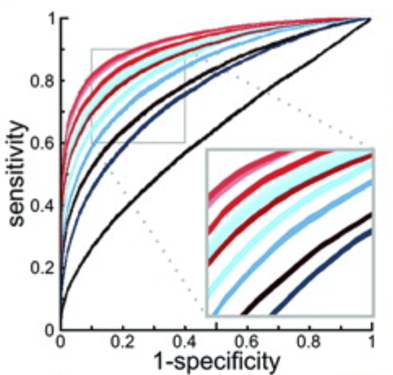
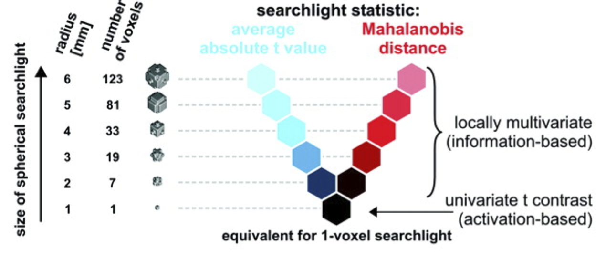
Validation of the Proposed Method

Slide 37
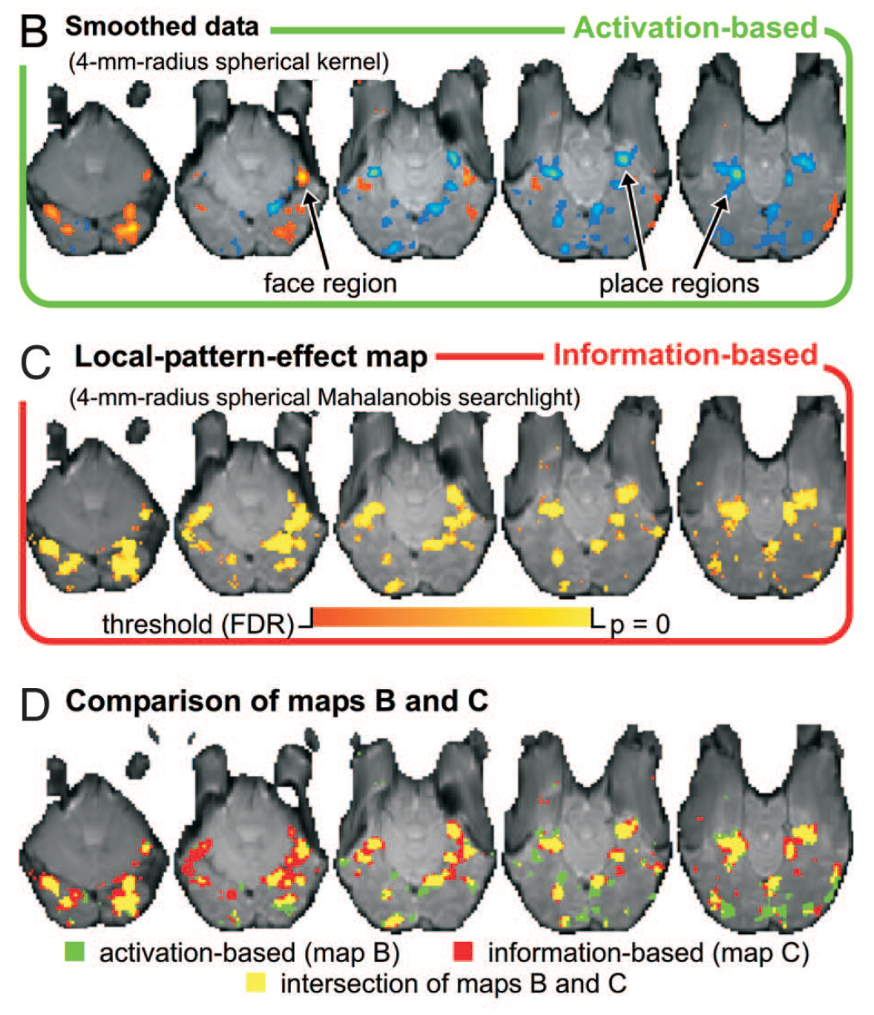
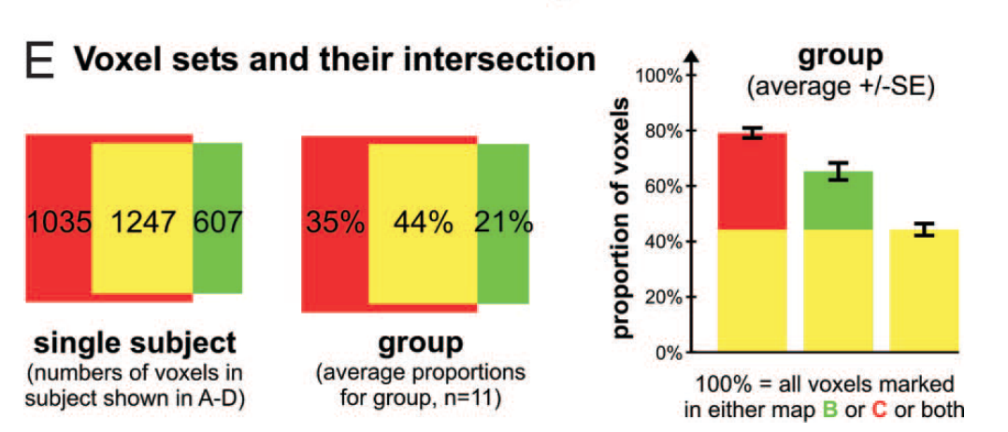
Validation of the Proposed Method
Puce A. , Allison T. , Gore J. C. , McCarthy G. (1995) J. Neurophysiol 74:1192–1199, pmid:7500143.

Slide 38
Validation of the Proposed Method
35%
Information are losted by smoothing
44%
Both techniques are sensitive to the extended activations
21%
Smoothness makes it more sensitive to weak extended activations

Slide 39
Examples
Jiang, Beck et al. 2015 – An insula-frontostriatal network mediates flexible

Slide 40
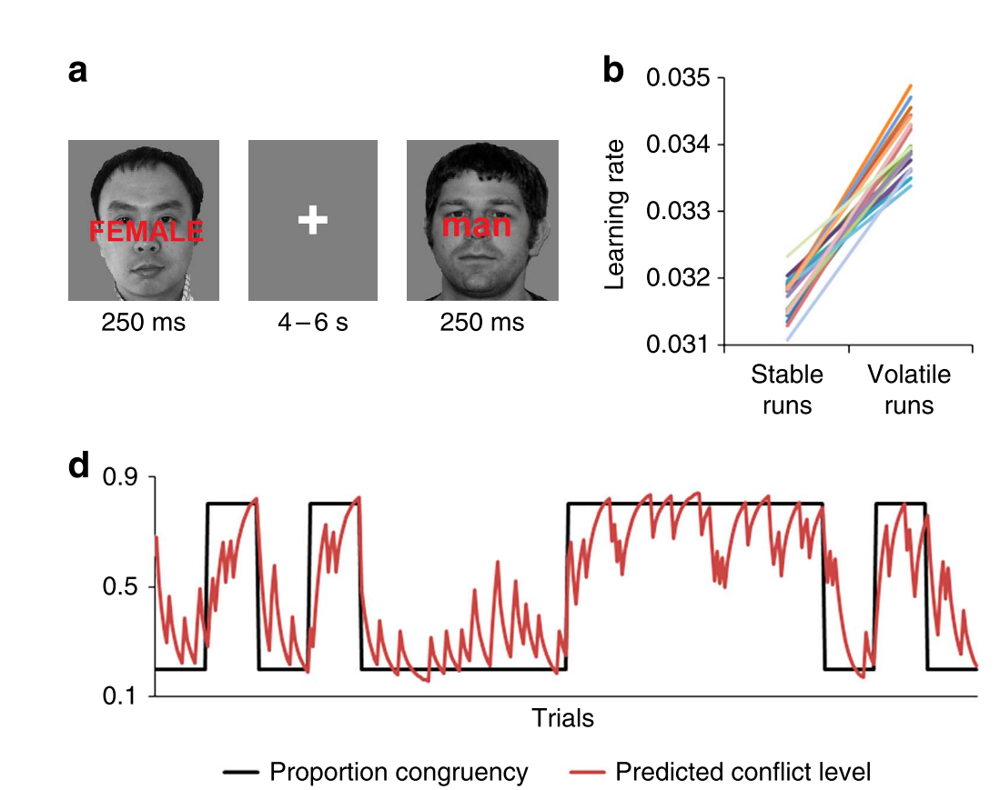
Exp Design

Slide 41
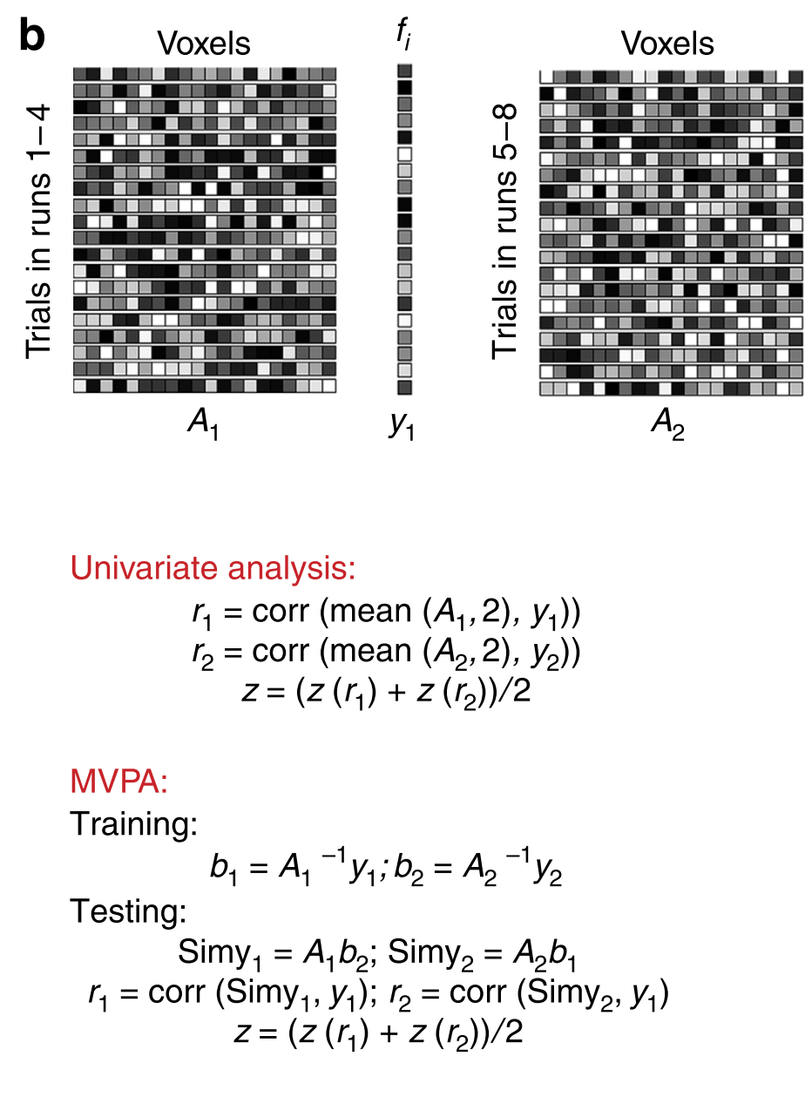
Searchlight
Sampling
Scanned through small clusters (radius: 2 voxels) of grey matter voxels
Two-fold averaging approach
Mapping
Z-score mapped to the center voxel of each searchlight
Smoothed using a Gaussian kernel of 6mm radius

Slide 42
RSA
Connecting the branches of systems neuroscience

Slide 43
Abstract
A fundamental challenge for neuroscience is to connect
brain-activity measurement
behavioral measurement
computational modeling
To solving this issue
abstracting from the activity patterns
computing representational dissimilarity matrices (RDMs)
RSA can measure neural activity in quantitatively relationship to each other on multi-channel

Slide 44
Q & A
A one-to-one mapping between model units and data channels
Require that the functional properties and real neurons are well characterized
Cannot assume a one-to-one correspondence (one voxel contains many neurons)
Different techniques may lead to different results
Neuroscientific theory must a new method
Elucidate in how far different modalities provide
Independent way of characterizing a brain region’s representation

Slide 45
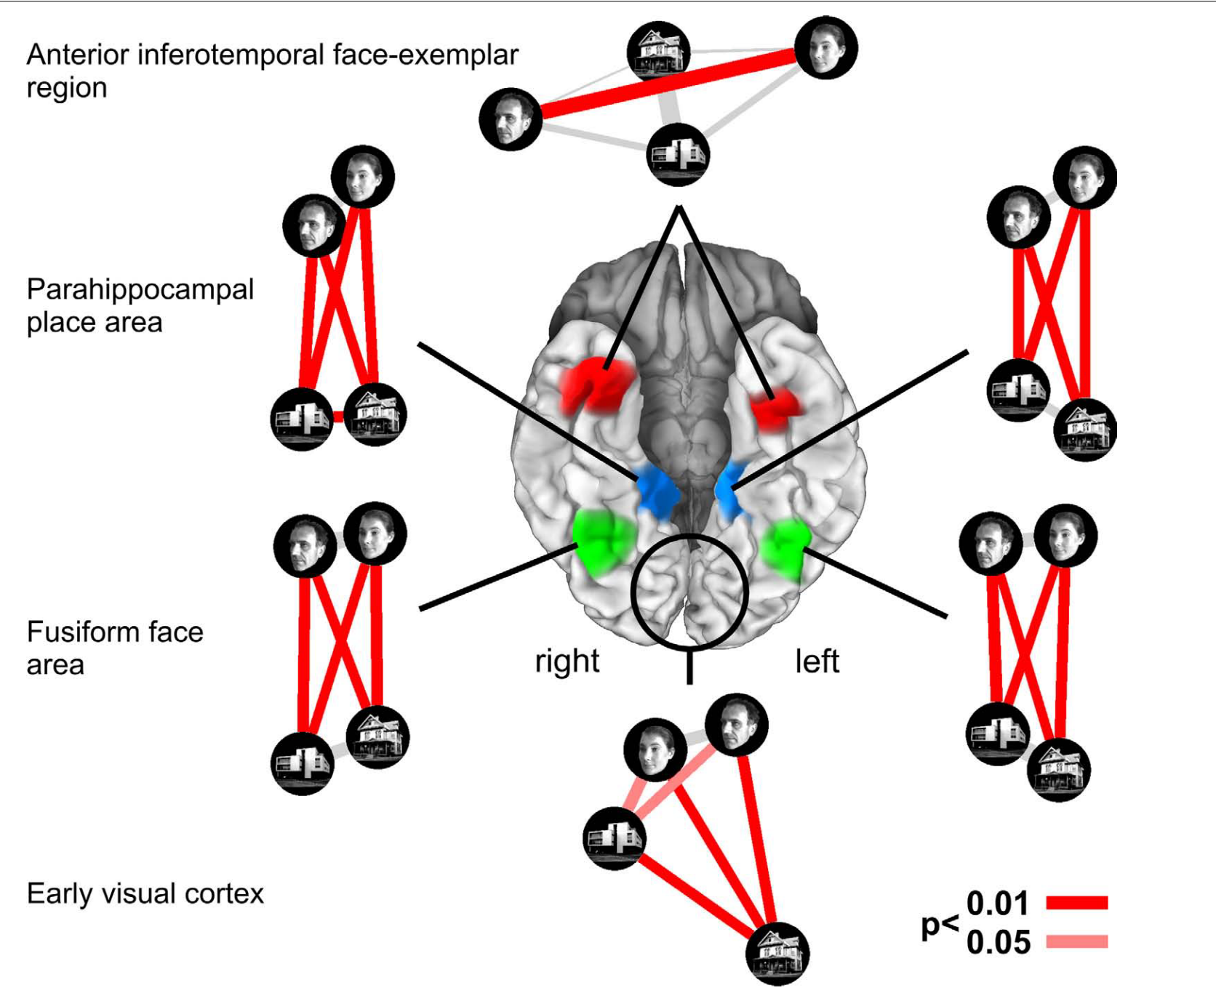

Slide 46
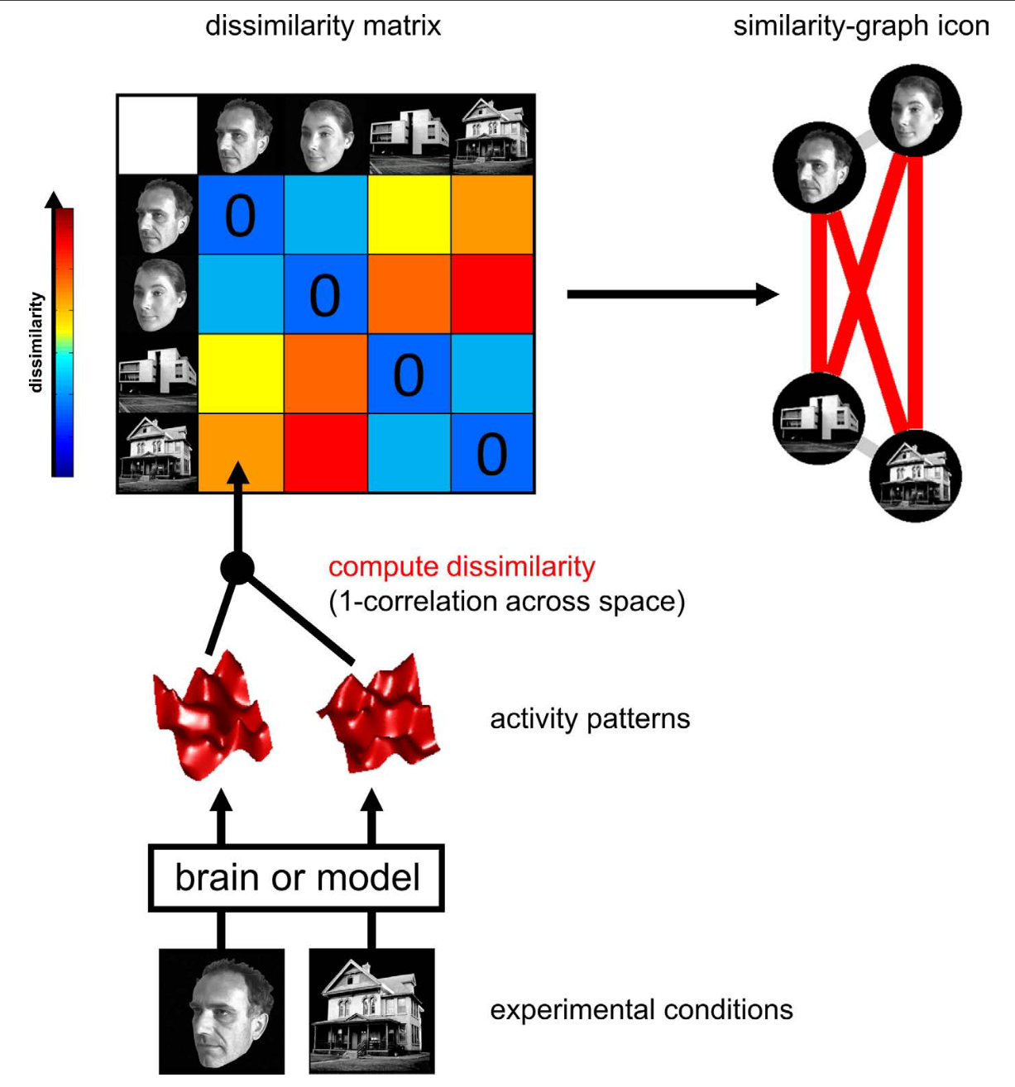
Method: THE REPRESENTATIONAL DISSIMILARITY MATRIX

Slide 47
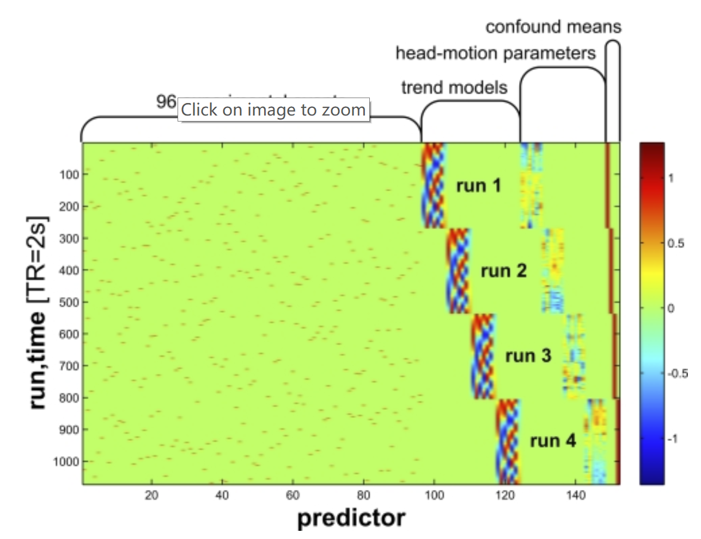
How-to
Step1 : ESTIMATING THE ACTIVITY PATTERNS
Proceeds independently for each region
Spatiotemporal patterns or simply temporal patterns from a single site as the input
Resulting condition-related activity patterns

Slide 48
How-to
Step1 : ESTIMATING THE ACTIVITY PATTERNS
Step2 : MEASURING ACTIVITY-PATTERN DISSIMILARITY
Compare the activity patterns associated with each pair of conditions
Method
Correlation distance (1 – cor)
Mahalanobis distance
Euclidean distance
Assembled in an RDM

Slide 49
How-to
Step1 : ESTIMATING THE ACTIVITY PATTERNS
Step2 : MEASURING ACTIVITY-PATTERN DISSIMILARITY
Step3 : PREDICTING REPRESENTATIONAL SIMILARITY WITH A RANGE OF MODELS

Slide 50
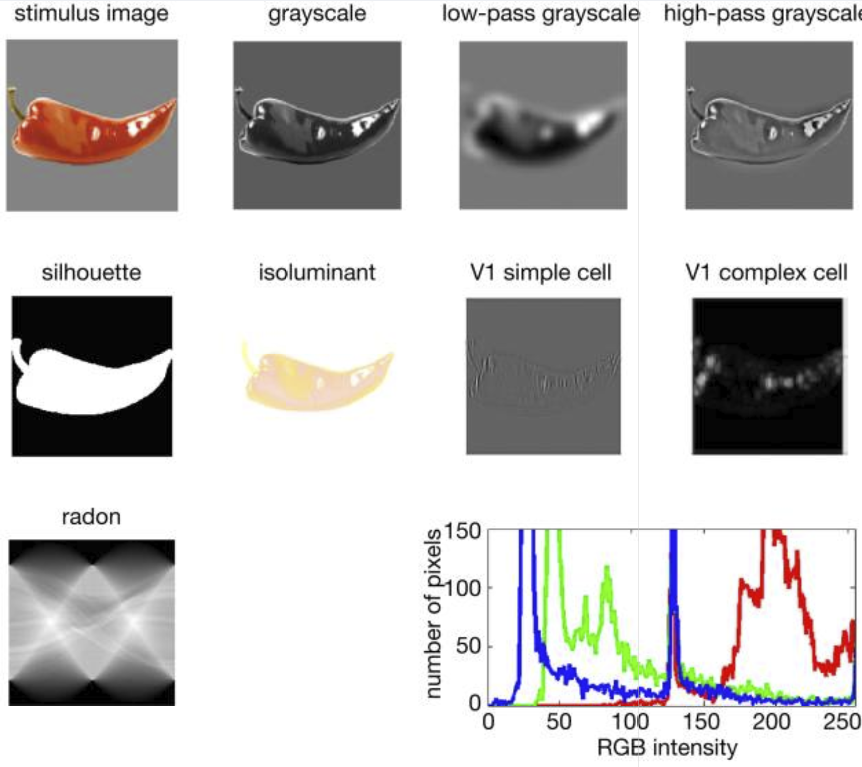

Slide 51
How-to
Step1 : ESTIMATING THE ACTIVITY PATTERNS
Step2 : MEASURING ACTIVITY-PATTERN DISSIMILARITY
Step3 : PREDICTING REPRESENTATIONAL SIMILARITY WITH A RANGE OF MODELS
Step4 : COMPARING BRAIN AND MODEL DISSIMILARITY MATRICES

Slide 52
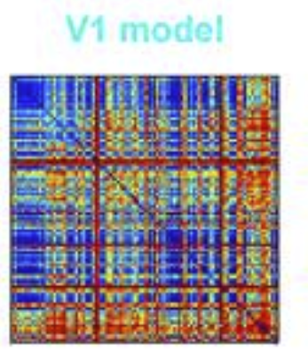
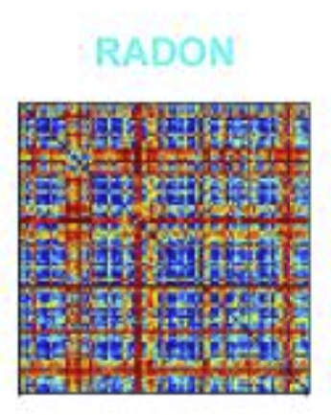
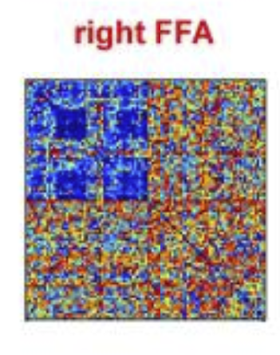
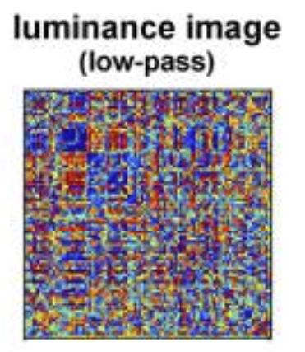

Slide 53
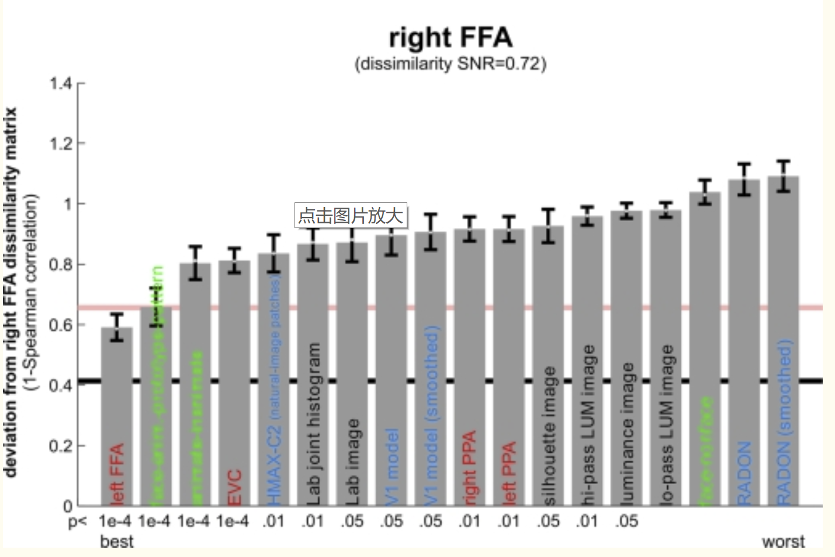
the deviations (1-Spearman correlation) of the models from each brain region’s RDM

Slide 54
How-to
Step1 : ESTIMATING THE ACTIVITY PATTERNS
Step2 : MEASURING ACTIVITY-PATTERN DISSIMILARITY
Step3 : PREDICTING REPRESENTATIONAL SIMILARITY WITH A RANGE OF MODELS
Step4 : COMPARING BRAIN AND MODEL DISSIMILARITY MATRICES
Step5 : VISUALIZING THE SIMILARITY STRUCTURE OF REPRESENTATIONAL DISSIMILARITY MATRICES BY MDS

Slide 55
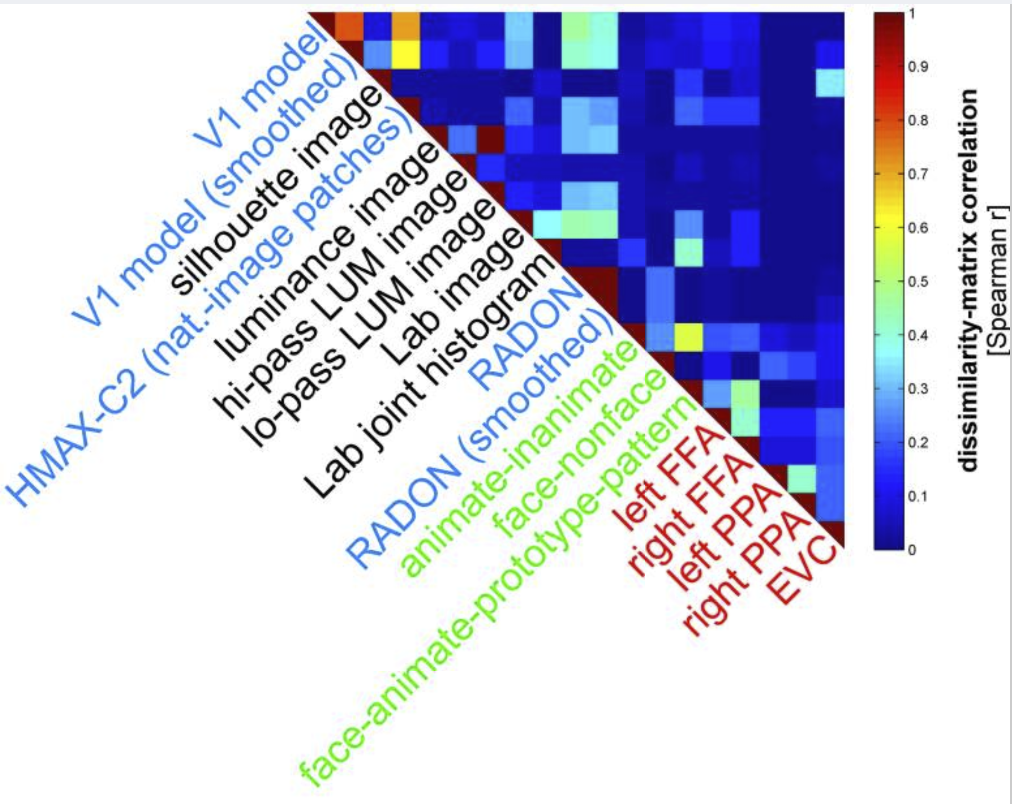

Slide 56
Results
The similarity active structure between FFA and EVC
Model fits to EVC and FFA
V1 for EVC
PPA for EVC
HMAX-C2 not for EVC
The five brain regions all related

Slide 57
Adv. Of RSA
Integration of computational modeling
Relating regions, subjects, species, and modalities of brain activity measurement
Relating brain and behavior
Suitable for condition-rich design

Slide 58
Leak in my presentation
Second-order isomorphism

Slide 59
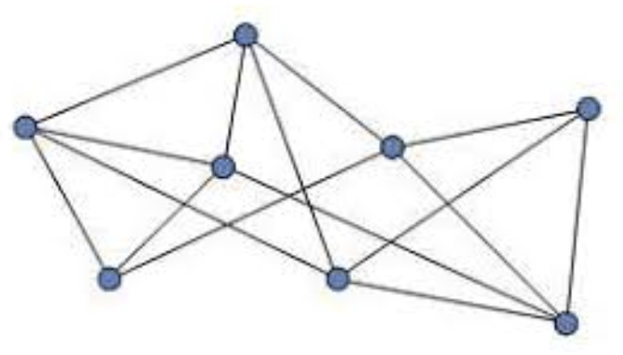
Leak in my presentation
Second-order isomorphism

Slide 60
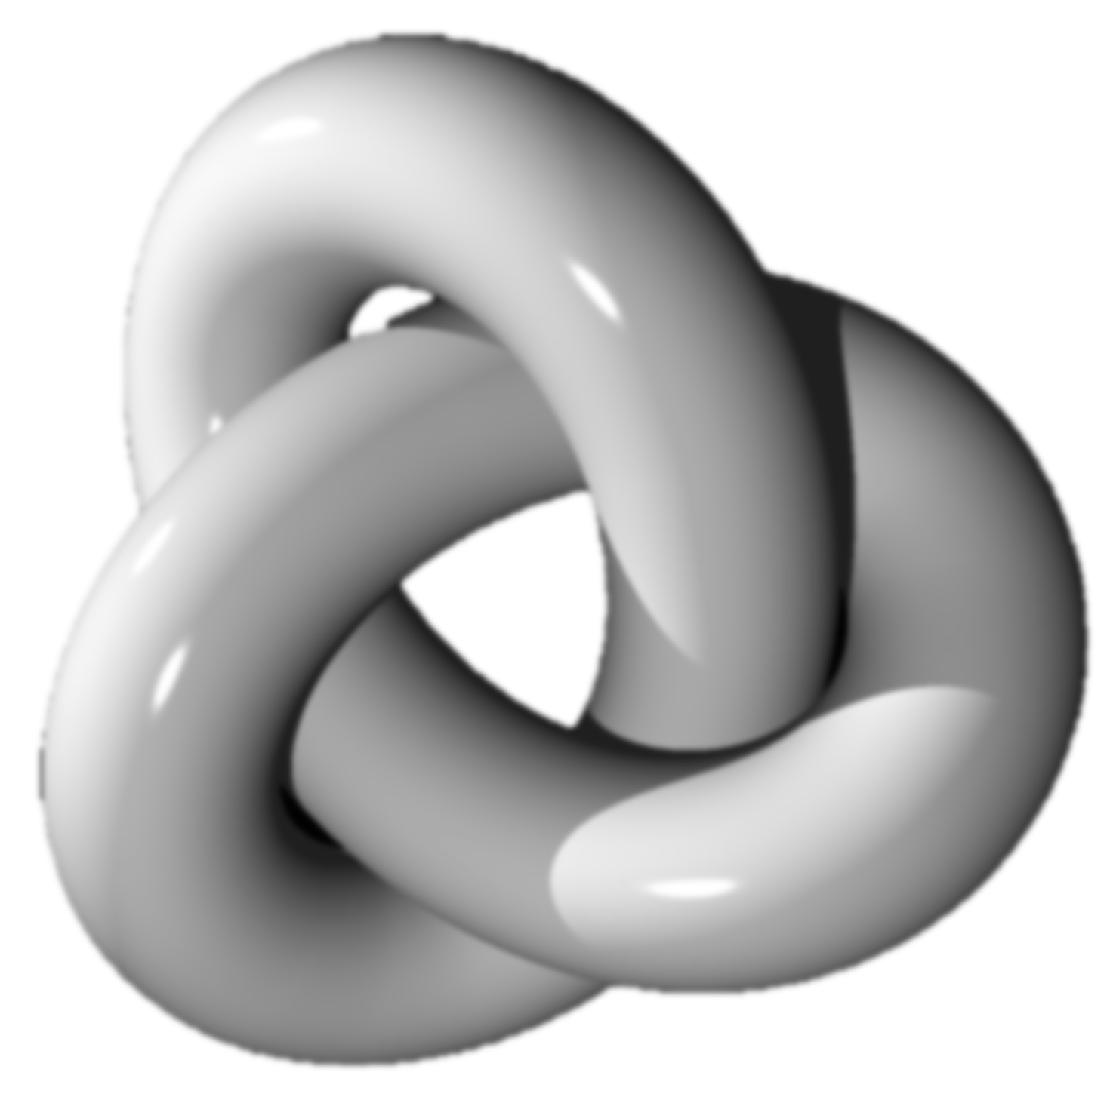
Leak in my presentation
Second-order isomorphism

Slide 61
Ref.
Kriegeskorte, Goebel et al. 2006 – Information-based functional brain mapping
Mahmoudi, Takerkart et al. 2012 – Multivoxel pattern analysis for FMRI
Kahnt, Grueschow et al. 2011 – Perceptual learning and decision-making
Jiang, Beck et al. 2015 – An insula-frontostriatal network mediates flexible
Kriegeskorte, Mur et al. 2008 – Representational similarity analysis
V. D. Sanchez et al. 2003 – Advanced support vector machines and kernel methods

